Slide 1
Statistics for linguists
2023-01-10 / 2023-01-17
Confounds (cont.), Multilevel / Hierarchical models

Slide 2
From last class
Confounds
Model fitting
Interactions
Multivariate regressions

Slide 3
Packages for today
library(ggdag)
library(ggplot2) library(VGAM)
library(ggExtra) library(tidyverse)
library(gridExtra)
library(lme4)
library(lmerTest)

Slide 4
Multivariate regression
Multivariate regression
Multivariate regression is (potentially) a powerful tool for distinguishing between cause and effect.
If used properly they can tell us the difference between cause and effect

Slide 5
Confounding types
Fork (see slides from 2 weeks)
Pipe
Collider
Descendent
Pearl, Judea. 2009. Causality: Models, Reasoning and Inference (Second Edition). Cambridge.
Pearl, Judea (& Dana Mackenzie). 2018. The Book of Why: The New Science of Cause and Effect. Penguin

Slide 6
Confounds or confounding
“If we undertake to estimate the effect of one variable (X) on another (Y) by examining the statistical association between the two, we ought to ensure that the association is not produced by factors other than the effect under study. The presence of spurious association – due, for example, to the influence of extraneous variables – is called confounding because it tends to confound our reading and to bias our estimate of the effect studied. Conceptually, therefore, we can say that X and Y are confounded when there is a third variable Z that influences both X and Y; such a variable is then called a confounder of X and Y.”
Pearl 2009: 183
Pearl, Judea. 2009. Causality: Models, Reasoning and Inference (Second Edition). Cambridge.

Slide 7
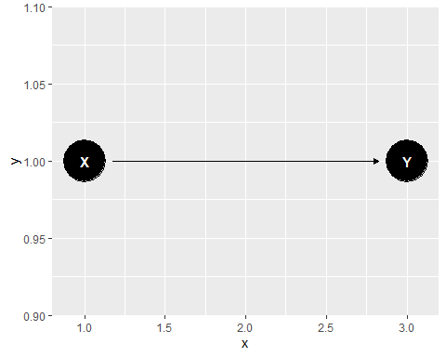
Fork
coord_dag <- list( x = c(X=1, Y=3), y = c(X=1, Y=1) ) our_dag <- ggdag::dagify(Y~X, coords = coord_dag) ggdag::ggdag(our_dag)

Slide 8
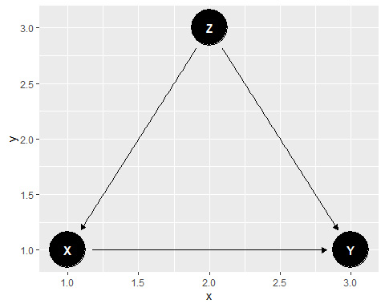
Fork
coord_dag <- list( x = c(X=1, Y=3, Z=2), y = c(X=1, Y=1, Z=3) ) our_dag <- ggdag::dagify(Y~X, X~Z, Y~Z, coords = coord_dag) ggdag::ggdag(our_dag)

Slide 9
Fork
To illustrate we can simulate the Fork confounder
set.seed(1234) z <- rnorm(100, 10, 10) b1 <- 2 b2 <- 3 a1 = 3 a2 = 4 y <- a1 + b1*z + rnorm(100, 0, 3) x <- a2 + b2*z + rnorm(100, 0, 3) d <- list(y, z, x) summary(lm(y~x, data=d))

Slide 10
summary(lm(y~x, data=d))
## ## Call: ## lm(formula = y ~ x, data = d) ## ## Residuals: ## Min 1Q Median 3Q Max ## -8.5904 -2.1783 0.0315 2.5965 7.1595 ## ## Coefficients: ## Estimate Std. Error t value Pr(>|t|) ## (Intercept) 0.52548 0.48810 1.077 0.284 ## x 0.65398 0.01148 56.953 <2e-16 *** ## --- ## Signif. codes: 0 '***' 0.001 '**' 0.01 '*' 0.05 '.' 0.1 ' ' 1 ## ## Residual standard error: 3.485 on 98 degrees of freedom ## Multiple R-squared: 0.9707, Adjusted R-squared: 0.9704 ## F-statistic: 3244 on 1 and 98 DF, p-value: < 2.2e-16

Slide 11
summary(lm(y~x, data=d))
## ## Call: ## lm(formula = y ~ x, data = d) ## ## Residuals: ## Min 1Q Median 3Q Max ## -8.5904 -2.1783 0.0315 2.5965 7.1595 ## ## Coefficients: ## Estimate Std. Error t value Pr(>|t|) ## (Intercept) 0.52548 0.48810 1.077 0.284 ## x 0.65398 0.01148 56.953 <2e-16 *** ## --- ## Signif. codes: 0 '***' 0.001 '**' 0.01 '*' 0.05 '.' 0.1 ' ' 1 ## ## Residual standard error: 3.485 on 98 degrees of freedom ## Multiple R-squared: 0.9707, Adjusted R-squared: 0.9704 ## F-statistic: 3244 on 1 and 98 DF, p-value: < 2.2e-16
There appears to be a significant relationship even though we know there is none.

Slide 12
summary(lm(y~x+z, data=d))
## ## Call: ## lm(formula = y ~ x + z, data = d) ## ## Residuals: ## Min 1Q Median 3Q Max ## -8.6577 -1.8151 0.0409 1.8996 8.6932 ## ## Coefficients: ## Estimate Std. Error t value Pr(>|t|) ## (Intercept) 2.7516 0.6181 4.452 2.28e-05 *** ## x 0.1027 0.1090 0.942 0.348 ## z 1.6817 0.3310 5.081 1.82e-06 *** ## --- ## Signif. codes: 0 '***' 0.001 '**' 0.01 '*' 0.05 '.' 0.1 ' ' 1 ## ## Residual standard error: 3.113 on 97 degrees of freedom ## Multiple R-squared: 0.9768, Adjusted R-squared: 0.9764 ## F-statistic: 2045 on 2 and 97 DF, p-value: < 2.2e-16
The relationship disappears when put in the actual causal factor

Slide 13
Pipe
Pipe: X → Z → Y causal chain, basically there is an intermediary causing factor. You are interested in the real world applications of changing X – if you add Z, it blocks the path of Y.
Adding Z introduces a confound in the assessment of X on Y
With a pipe adding a variable introduces a confound in the model

Slide 14
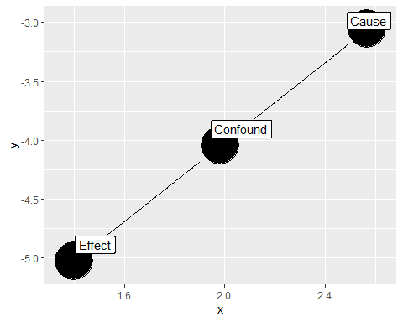
Pipe
pipe.example <- dagify(Y~Z, Z~X, labels = c( "X" = "Cause", "Y" = "Effect", "Z" = "Confound" ) ) ggdag(pipe.example, text=FALSE, use_labels = "label")
Case -> Confound -> Effect
Or we can distinguish between a more or less proximal cause
McElreath ...

Slide 15
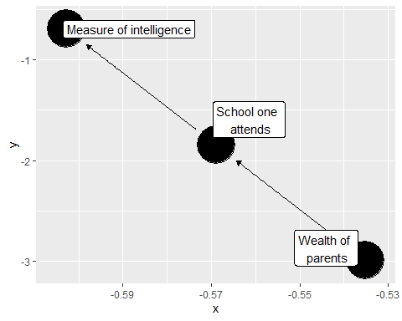
Pipe
pipe.example <- dagify(Y~Z, Z~X, labels = c( "X" = "Wealth of \n parents", "Y" = "Measure of intelligence", "Z" = "School one \n attends" ) ) ggdag(pipe.example, text=FALSE, use_labels = "label")
For example, we might think that wealth inequality is related to differences in test scores in the following way.
We might be interested in improving test scores ...?

Slide 16
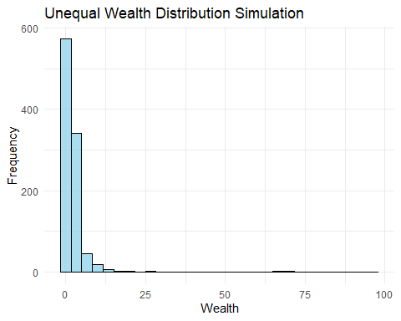
Simulating wealth inequality
num_individuals <- 1000 alpha <- 1.5 #how unequal they are going to be wealth_distribution <- rpareto(num_individuals, shape=alpha) df <- data.frame(Wealth = wealth_distribution) ggplot(df, aes(x = Wealth)) + geom_histogram(bins = 30, fill = "skyblue", color = "black", alpha = 0.7) + labs(title = "Unequal Wealth Distribution Simulation", x = "Wealth", y = "Frequency") + theme_minimal()

Slide 17
Simulating SAT scores as a function of wealth
x1 <- 0.7 x2 <- 0.2 yearly_income_of_parents <- wealth_distribution*40000 school_attended_quality <- yearly_income_of_parents*x1 + rnorm(n=1000, m=0, sd=4000) test_taking_ability <- school_attended_quality*x2 + rnorm(n=1000, m=0, sd=30000)
test_score <- (test_taking_ability - min(test_taking_ability)) / (max(test_taking_ability) - min(test_taking_ability)) test_score <- (test_score * 1600)+400 SAT <- numeric(length(test_score)) # Loop through each element in the original vector for (i in seq_along(test_score)) { # Check if the value is above 1600 if (test_score[i] > 1600) { # If yes, set it to 1600 SAT[i] <- 1600 } else { # If no, keep the original value SAT[i] <- test_score[i] } } hist(SAT)

Slide 18
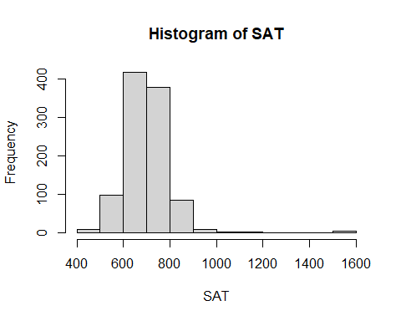
Simulating SAT scores as a function of wealth
SAT scores vary from 400 to 1600
df <- data.frame(wealth = yearly_income_of_parents, school = school_attended_quality, SAT = SAT) summary(lm(SAT~wealth, data = df))

Slide 19
## ## Call: ## lm(formula = SAT ~ wealth, data = df) ## ## Residuals: ## Min 1Q Median 3Q Max ## -295.423 -46.367 1.248 45.962 270.363 ## ## Coefficients: ## Estimate Std. Error t value Pr(>|t|) ## (Intercept) 6.658e+02 2.556e+00 260.48 <2e-16 *** ## wealth 3.155e-04 1.001e-05 31.53 <2e-16 *** ## --- ## Signif. codes: 0 '***' 0.001 '**' 0.01 '*' 0.05 '.' 0.1 ' ' 1 ## ## Residual standard error: 72.99 on 998 degrees of freedom ## Multiple R-squared: 0.499, Adjusted R-squared: 0.4985 ## F-statistic: 994.1 on 1 and 998 DF, p-value: < 2.2e-16

Slide 20
summary(lm(SAT~wealth+school, data = df))
## ## Call: ## lm(formula = SAT ~ wealth + school, data = df) ## ## Residuals: ## Min 1Q Median 3Q Max ## -290.644 -47.539 2.689 45.726 273.952 ## ## Coefficients: ## Estimate Std. Error t value Pr(>|t|) ## (Intercept) 6.657e+02 2.549e+00 261.119 <2e-16 *** ## wealth -6.706e-04 3.931e-04 -1.706 0.0884 . ## school 1.408e-03 5.613e-04 2.509 0.0123 * ## --- ## Signif. codes: 0 '***' 0.001 '**' 0.01 '*' 0.05 '.' 0.1 ' ' 1 ## ## Residual standard error: 72.8 on 997 degrees of freedom ## Multiple R-squared: 0.5022, Adjusted R-squared: 0.5012 ## F-statistic: 502.8 on 2 and 997 DF, p-value: < 2.2e-16

Slide 21
Causal chain
Do we conclude that changing wealth will not have an influence of SAT scores?
We couldn’t conclude that because we blocked the causal chaing from wealth to SAT scores.

Slide 22
Random effects
Random variable: You model the something from a distribution (e.g. a normal distribution) where you assume that a given element is being pulled out ‘randomly’ (think about rnorm() etc.)
Random effects: In models we have learnt so far the predictor(s)/effects and the errors are random variables, intercepts and slopes are constants, in random effects models your intercepts and/or slopes are random variables.
How? It’s best to imagine a random effects model as a bunch of linear models ...

Slide 23
Random effects
Random effects models, multilevel model, hierarchical models are (usually) used interchangeability
Random effects model: slopes and/or intercepts are random variables, note by random we mean they come from a definable distribution.
Multilevel model: By making the slopes and intercepts random you are automatically entailing that your model has more than one regression (line)

Slide 24
Fixed effects
Fixed effects: Your effects (intercept and slope) do not come from a random distribution, they are just fixed throughout the model.
Unfortunately, sometimes it can mean different things.
‘The term fixed effects is used in contrast to random effects – but not in a consistent way! Fixed effects are usually defined as varying coefficients that are not themselves modeled. For example, a classifical regression including J – 1 = 19 city [group] indicators as regression predictors is sometimes called a “fixed-effects model” or a model with “fixed effects for cities [groups]”. Confusingly, however, “fixed-effects models” sometimes refer to regressions in which coefficients do not vary by group (so that they are fixed, not random)’
Gelman, Andrew & Jennifer Hill. 2007. Data Analysis Using Regression and Multilevel/Hierchical Models. Cambridge University Press.

Slide 25
Random effects
Relevant for when the relationships you are interested in modelling involve a population that can be divided into groups.
E.g. you are interested in reaction time, but results vary by speakers
E.g. you are interested in test scores, but results vary by school

Slide 26
Pooling
Complete Pooling means that you just combine all the data points across the groups.
Non-pooling means you run separate models for each group.
Multilevel models rely on partial pooling – you use information from inside the group and from the whole population simultaneously.
Gelman, Andrew & Jennifer Hill. 2007. Data Analysis Using Regression and Multilevel/Hierchical Models. Cambridge University Press.

Slide 27
Random vs. fixed effects
When to use random vs. fixed effects?
‘In endeavoring to decide whether a set of effects is fixed or random, the context of the data, the manner in which they were gathered and the environment from which they came are the determining factors. In considering these points the important question is that of inference: are the levels of the factor going to be considered a random sample from population of values? “Yes” – then the effects are to be considered as random effects. “No” – then, presumably inferences will be made just about the levels occurring in the data and the ffects are considered as fixed effects. Thus when inferences will be made about a population of effects from which those in the data are considered to be a random sample, the effects are considered as random; and when inferences are going to be used to the effects in the model, the effects are considered fixed.’ (p. 16)
Searle, Shayle R., Casella, George & Charles E. McCulloch. 1992/2006. Variance Components. Wiley-Interscience.

Slide 28
‘A question that commonly arises is when to use fixed effects (in the sense of varying coefficients that are unmodeled) and when to use random effects. The statistical literature is full of confusing and contradictory advice. Some say that fixed effects are appropriate if group-level coefficients are of interest, and random effects are appropriate if interest lies in the underlying population. Others recommend fixed effects when the groups in the data represent all possible groups, and random effects when the population includes groups not in the data. .. Our advice ... is to always use multilevel modeling (“random effects”)’ (p. 245-246)
Gelman, Andrew & Jennifer Hill. 2007. Data Analysis Using Regression and Multilevel/Hierchical Models. Cambridge University Press.

Slide 29
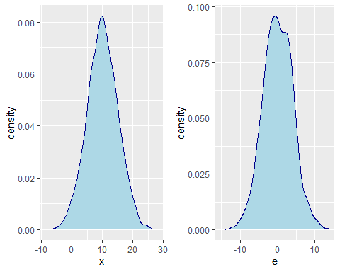

Normal regression model
$y=a+b_{1}x+$ e
e <- rnorm(m=0, sd=4, n=2000) x <- rnorm(m=10, sd=5, n= 2000) a <- 10 b <- 5 y <- a + b * x + e d <- data.frame(x, e) plot_x <- ggplot(d, aes(x=x))+ geom_density(linetype="solid", fill="lightblue", color="darkblue") plot_e <- ggplot(d, aes(x=e))+ geom_density(linetype="solid",fill="lightblue", color="darkblue") grid.arrange(plot_x, plot_e, ncol=2)
These are random variables because they come from random distributions

Slide 30
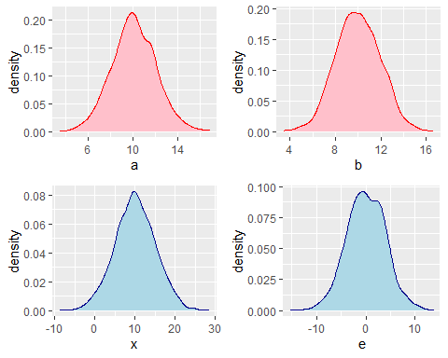

Multilevel model
$y=a_{j[i]}+b_{j\left[i\right] }x_{i}+$ e
$y=a+b x_{i}+$ e
$y=a+b x_{i}+$ e
$y=a+b x_{i}+$ e
...

Slide 31
x <- seq(1, 3, by=0.1 ) a1 <- 10 a2 <- 20 a3 <- 30 b1 <- 10 b2 <- 10 b3 <- 10 y1 <- a1 + x*b1 d1 <- data.frame(y=y1,x) y2 <- a2 + x*b2 d2 <- data.frame(y=y2,x) y3 <- a3 + x*b3 d3 <- data.frame(y=y3,x) d1$group = "1" d2$group = "2" d3$group = "3" d <- rbind(d1,d2,d3) plot_01 <- ggplot(d, aes(x=x, y=y, shape=group))+ geom_smooth(method=lm, se=FALSE, fullrange=TRUE, aes(color=group))
x <- seq(1, 3, by=0.1 ) a1 <- 10 a2 <- 10 a3 <- 10 b1 <- 10 b2 <- 20 b3 <- -10 y1 <- a1 + x*b1 d1 <- data.frame(y=y1,x) y2 <- a2 + x*b2 d2 <- data.frame(y=y2,x) y3 <- a3 + x*b3 d3 <- data.frame(y=y3,x)
d1$group = "1" d2$group = "2" d3$group = "3" d <- rbind(d1,d2,d3) plot_02 <- ggplot(d, aes(x=x, y=y, shape=group))+ geom_smooth(method=lm, se=FALSE, fullrange=TRUE, aes(color=group)) x <- seq(1, 3, by=0.1 ) a1 <- 10 a2 <- 10 a3 <- 30 b1 <- 10 b2 <- 20 b3 <- -10 y1 <- a1 + x*b1 d1 <- data.frame(y=y1,x) y2 <- a2 + x*b2 d2 <- data.frame(y=y2,x) y3 <- a3 + x*b3 d3 <- data.frame(y=y3,x) d1$group = "1" d2$group = "2" d3$group = "3" d <- rbind(d1,d2,d3) plot_03 <- ggplot(d, aes(x=x, y=y, shape=group))+ geom_smooth(method=lm, se=FALSE, fullrange=TRUE, aes(color=group)) grid.arrange(plot_01, plot_02, plot_03, nrow=3)

Slide 32
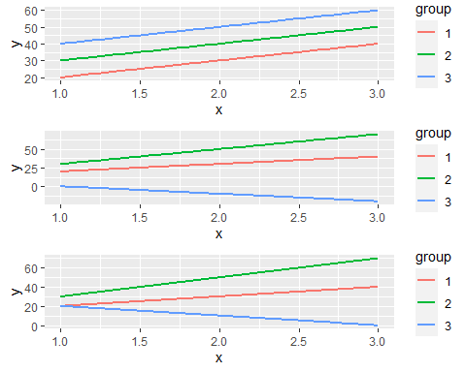



$$y=a_{i}+b_{ }x+e$$
$$y=a+{b_{i}}_{ }x+e$$
$y=a_{j[i]}+b_{j\left[i\right] }x_{i}+$ e
Gelman, Andrew & Jennifer Hill. 2007. Data Analysis Using Regression and Multilevel/Hierchical Models. Cambridge University Press.

Slide 33
Simulation exercise
Simulation exercise with ‘Schools’ as random effects
See word document and follow along copying relevant code

Slide 34
Please read
Ch. 11 and 12 of Gelman & Hill
Moran et al. 2012. Revisiting population size vs. phoneme inventory size. Language Vol. 88, No. 4. 877-893.

